Slide 1
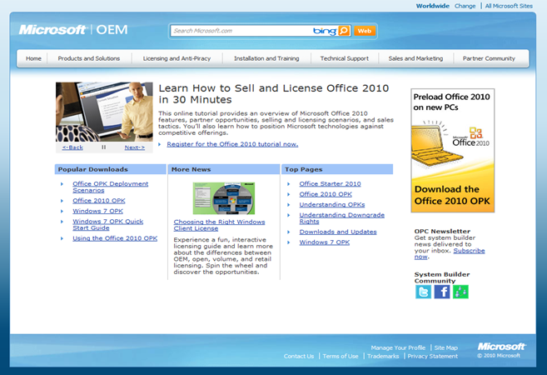
OEM Enterprise Content Management
The Challenge
Microsoft needed to provide OEM Partners with a seamless, targeted online experience. Microsoft drives billions in revenue through the stability of this channel. Affirma was entrusted with the development of this mission critical extranet to serve the needs of this vital community.
What We Did
Affirma designed the portal from the ground up, leveraging SharePoint 2010 as one of the earliest large external website implementations on the technology. The site went to production prior to the release of SharePoint 2010 to the public. We architected the site to allow a very diverse user base to navigate and discover large amounts of crucial information for their business. At the time, SharePoint was being used mostly as an intranet and document repository. This is an early adopter example of a SharePoint Extranet rolled out with best practices, from infrastructure to content authoring.
Results
The resulting website leveraged publishing and enterprise content management and was localized in multiple languages. The portal provided a seamless online experience, was delivered on time and under budget, and allowed billions in revenue through the stability of this channel. This was one of the earliest Extranet implementations on SharePoint. We are currently working on subsequent phases.

